Slide 1
William Roberts CIS216 – Task 10 Prof. Stephen Leggett

Slide 2
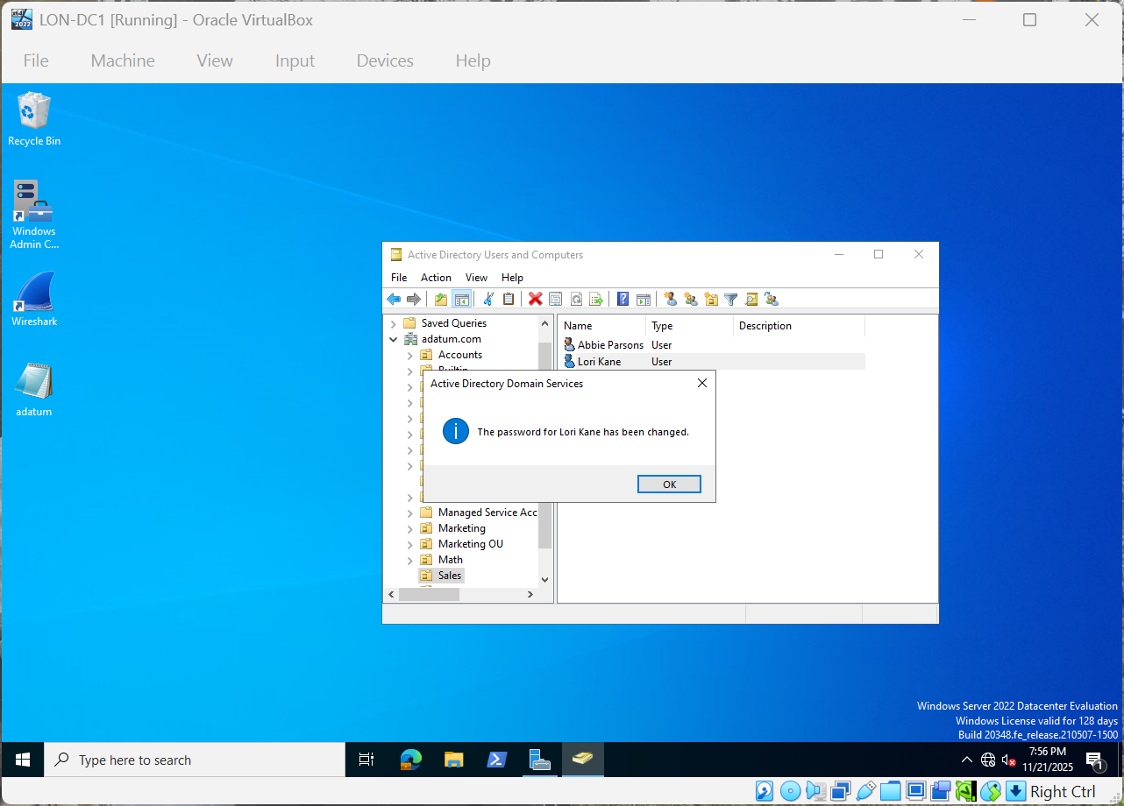
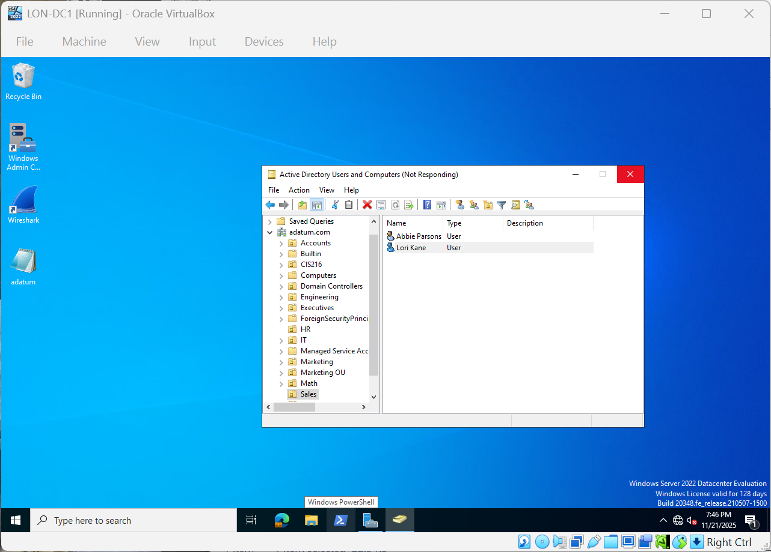
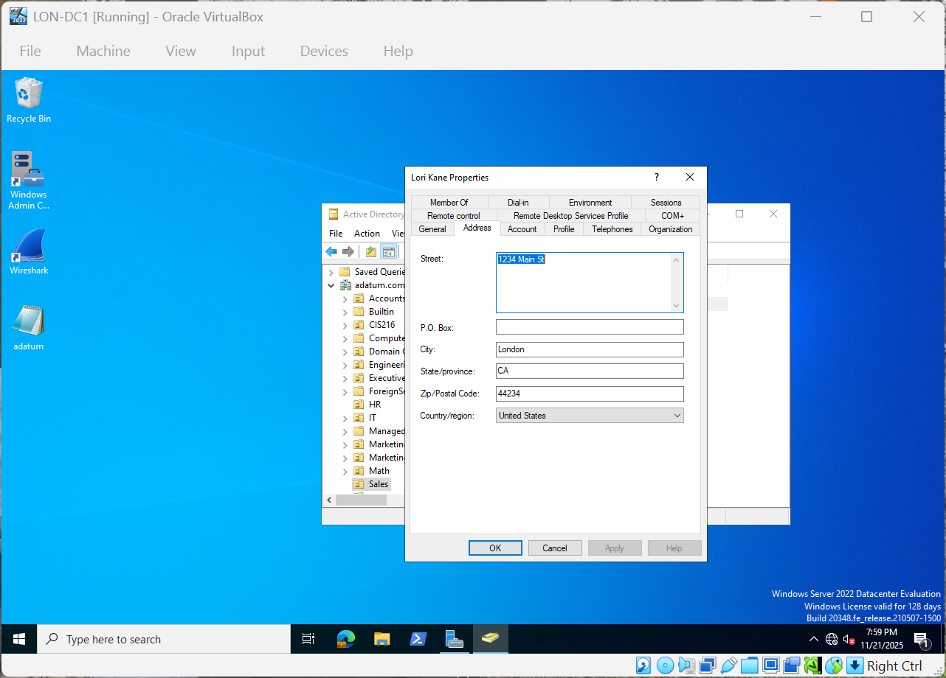
Add user and set up account info

Slide 3
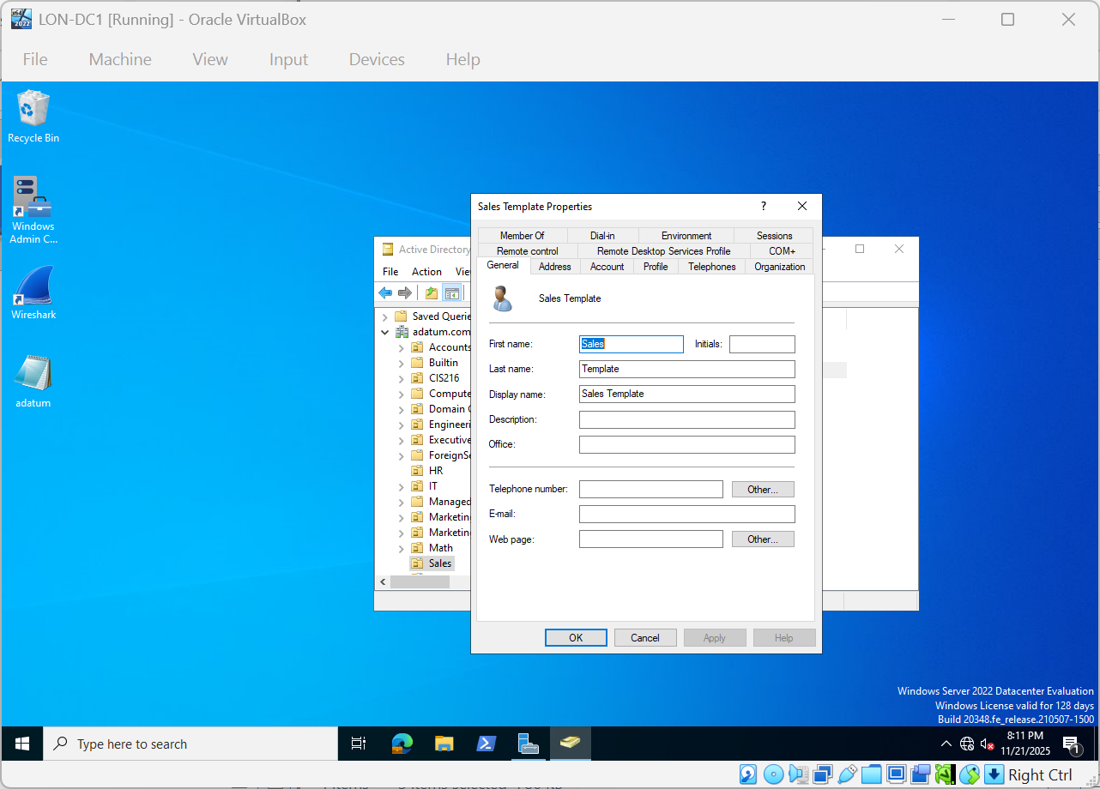
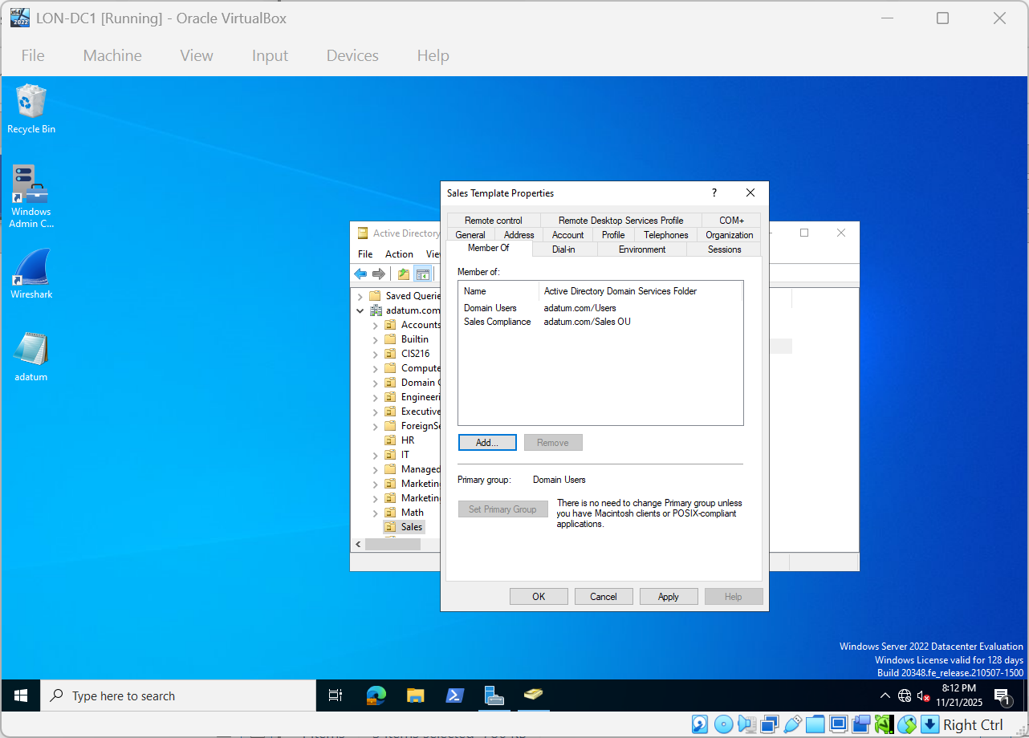
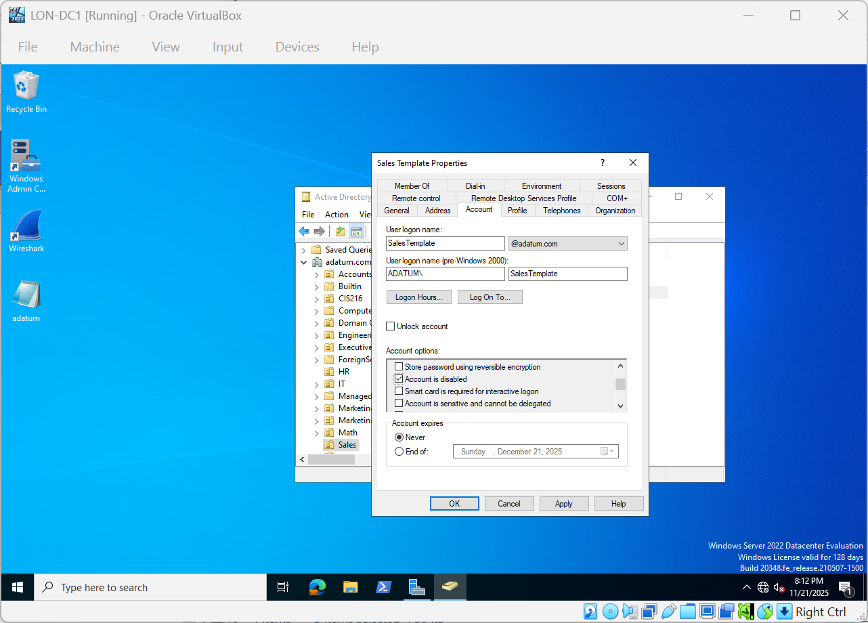
Create User Template

Slide 4

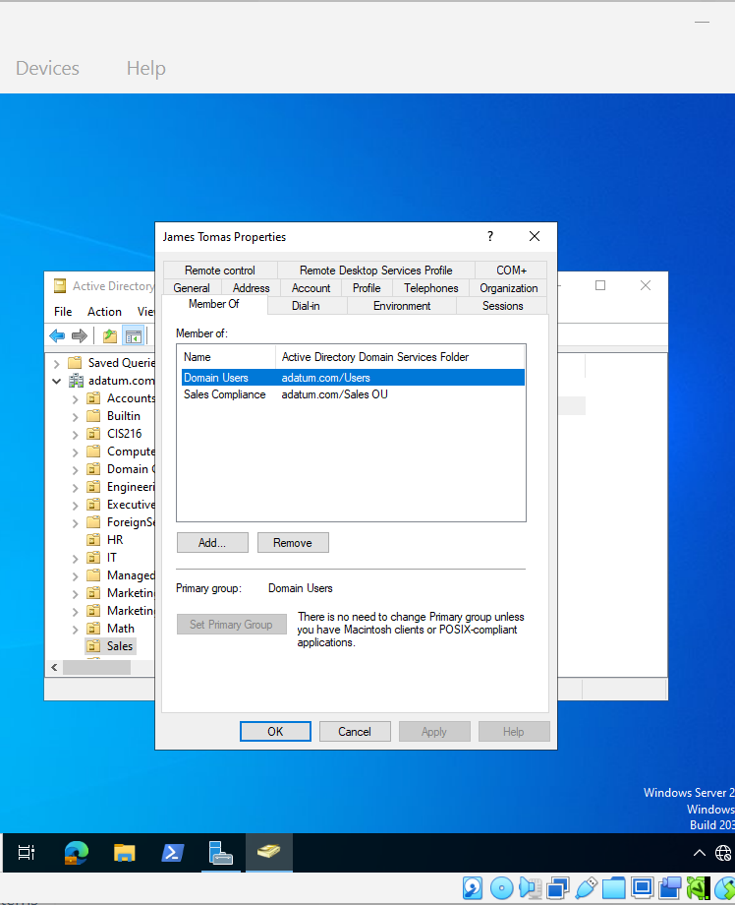

Using User Template to make James and check members of

Slide 5

Creating Computer Objects

Slide 6

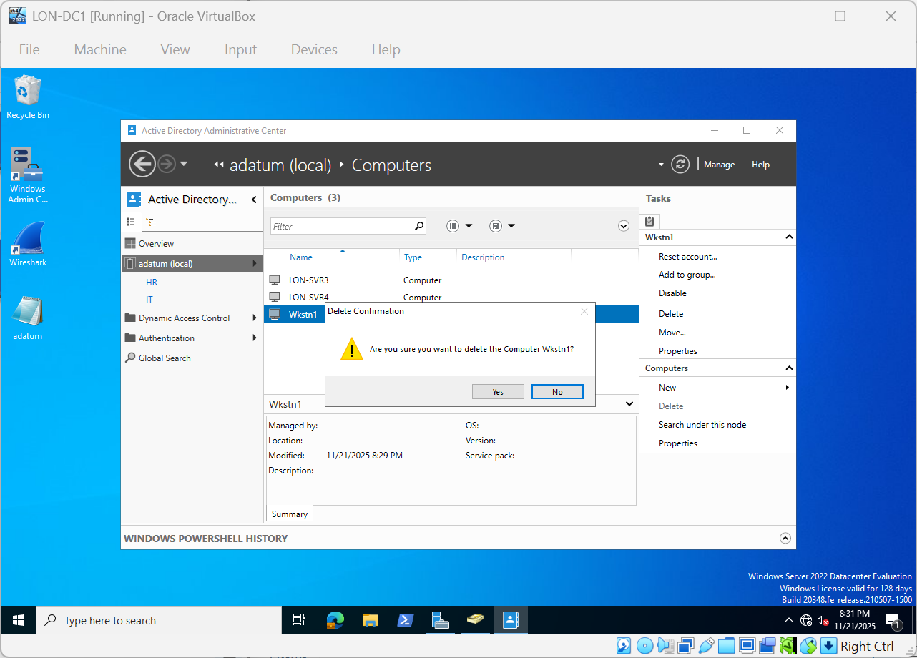
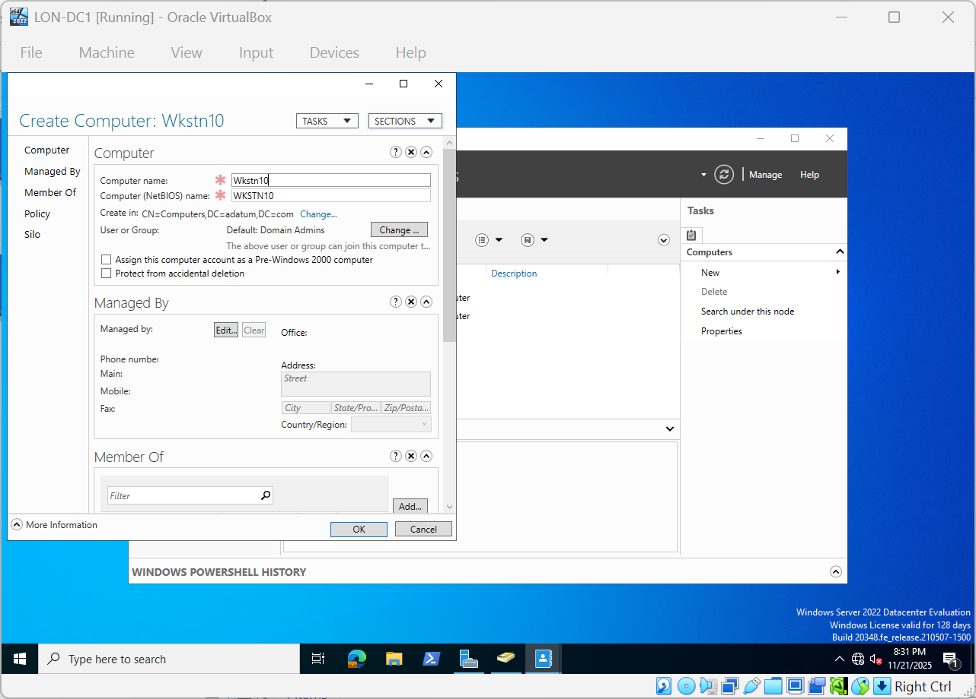
Delete just made computer create new one in AD AdminCenter

Slide 7

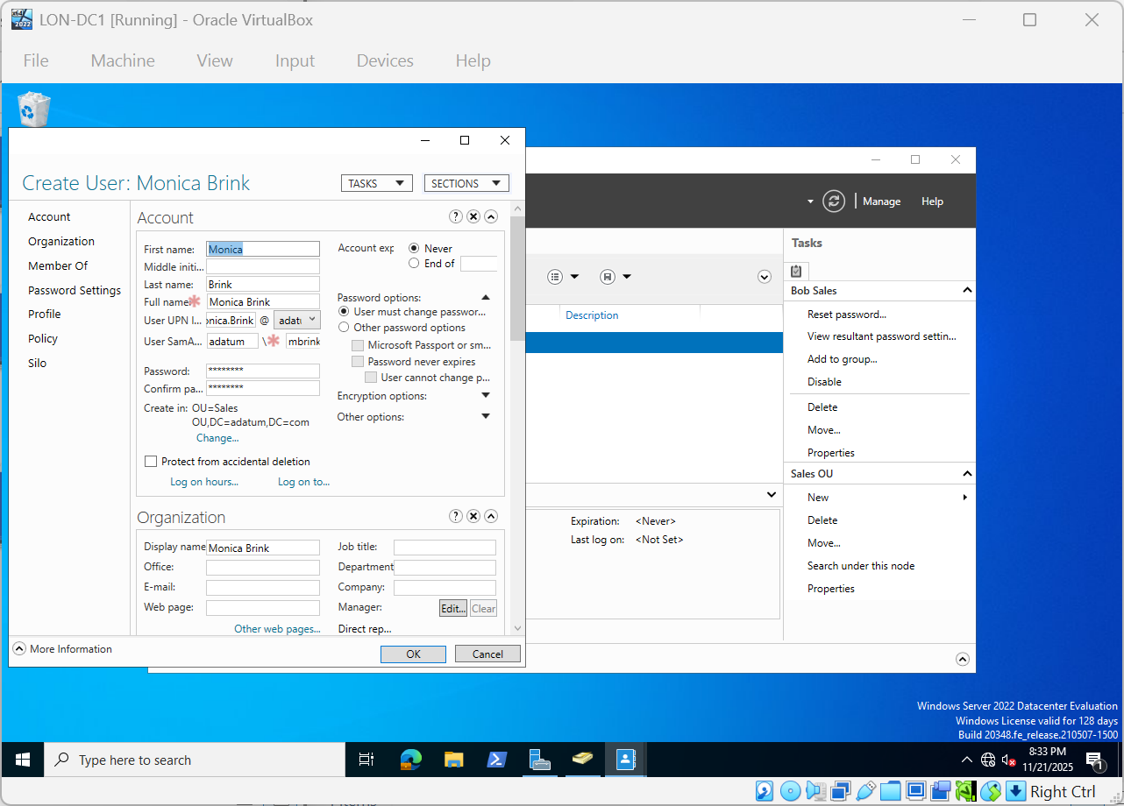
Crate user and add to Sales

Slide 8
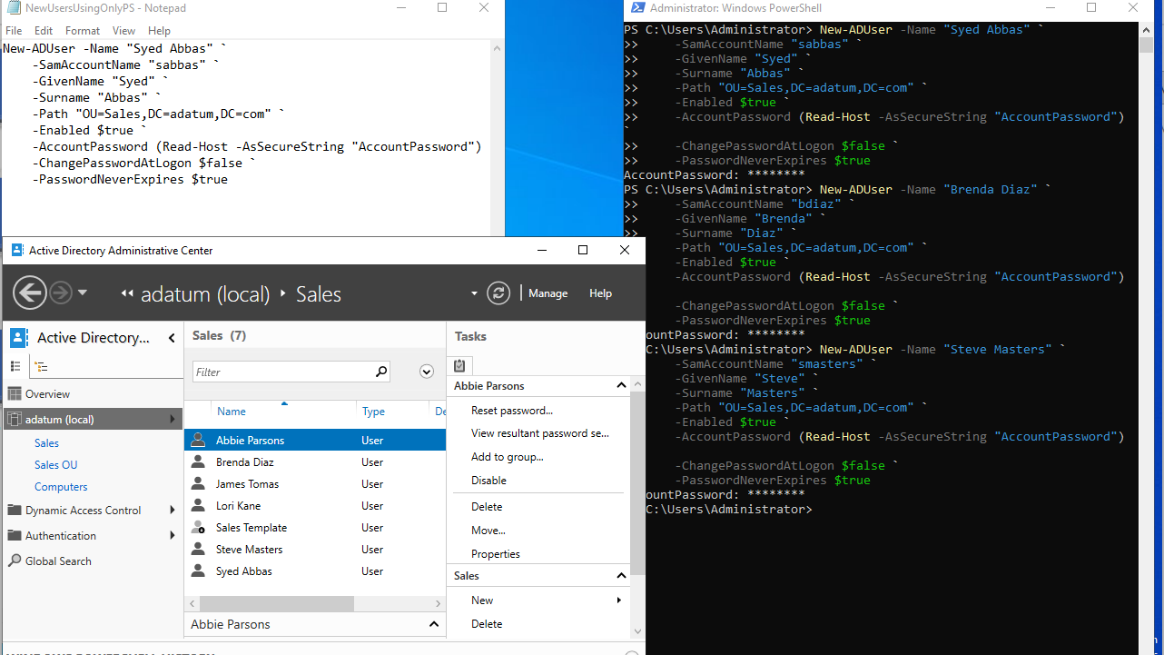
Add Users Using Only Powershell

Slide 9
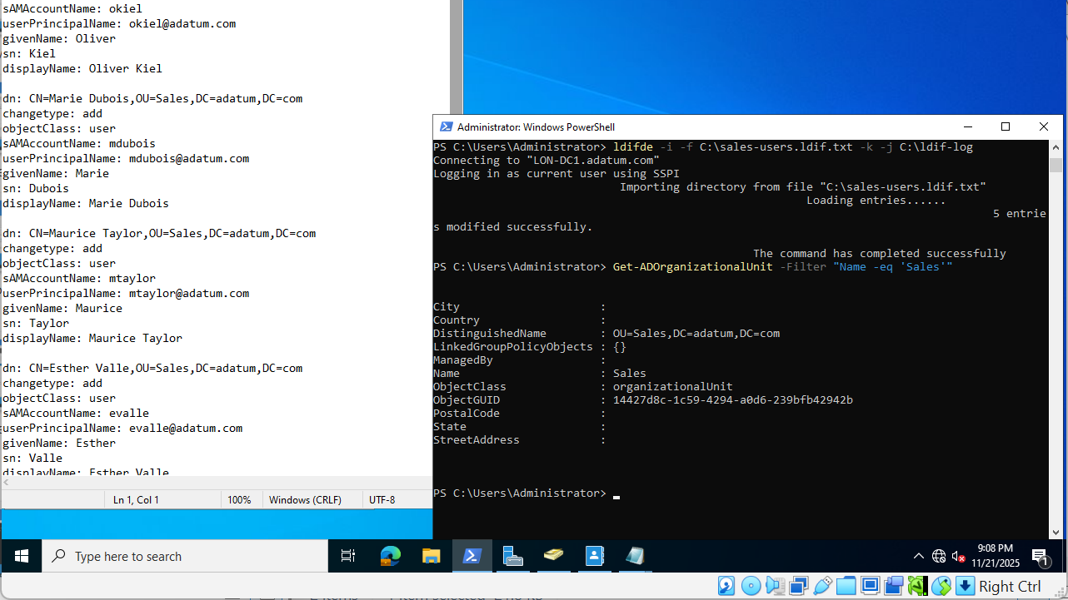
Creating Multiple Users Using LDIFDE

